Slide 1


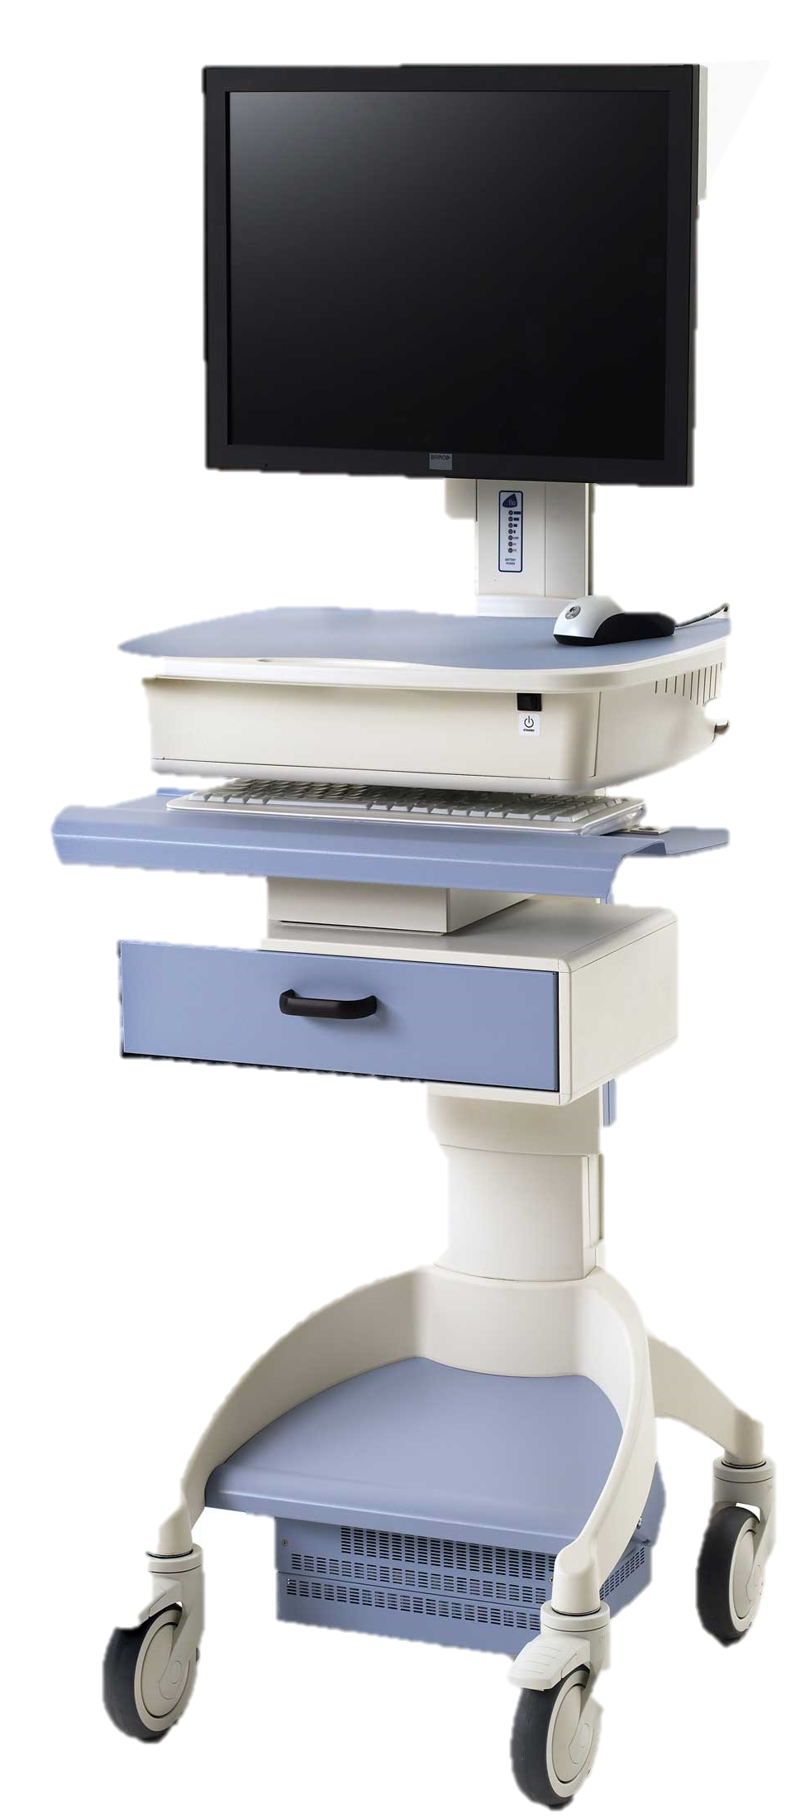
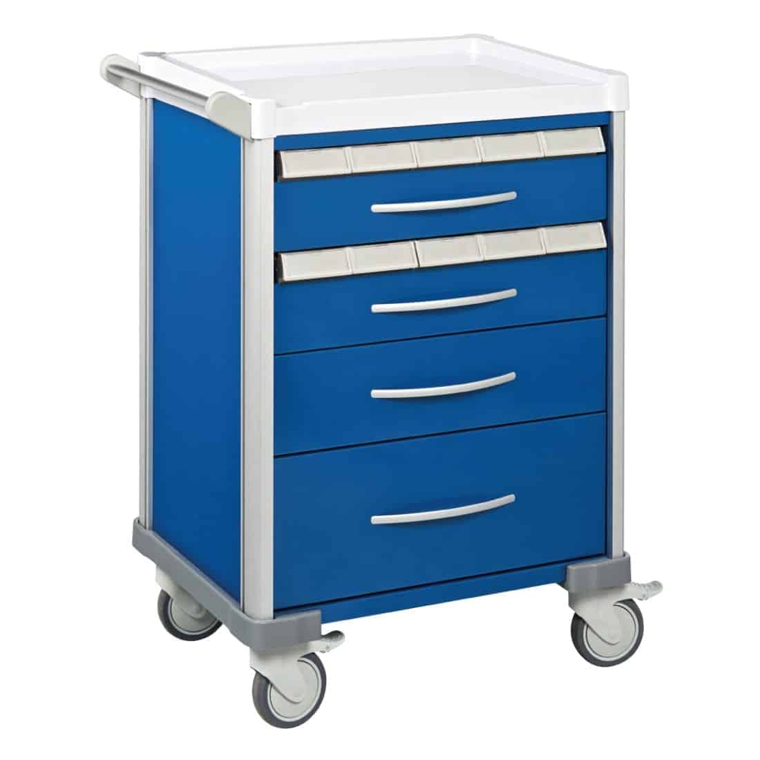
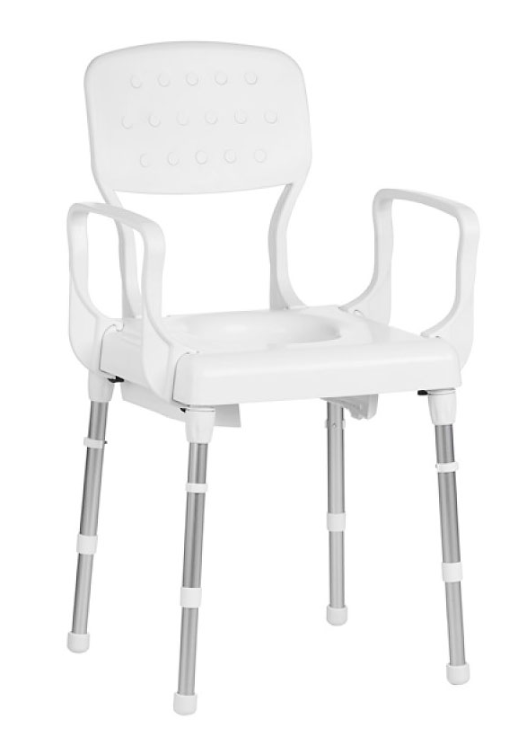
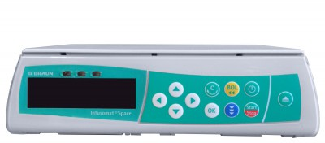
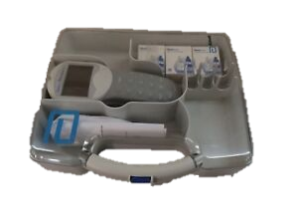

The CLEEN study
CLEaning and Enhanced disiNfection
October results Ward A
35% of shared medical equipment was cleaned
That’s 47% LESS than last month, so there’s definitely room for improvement
This month we are focusing on cleaning
Infusion pump
Blood testing kit
Medication trolley
Commode
COWs
Congratulations to X & and B for the highest % of clean equipment!
For more information, visit XXX
Or email XXX

Slide 2
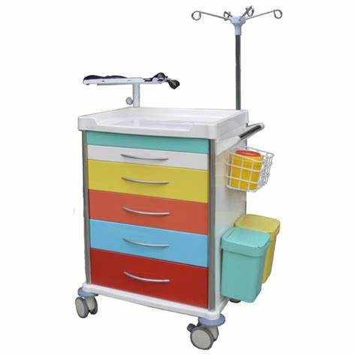
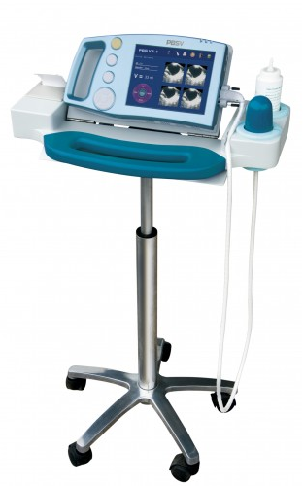
The CLEEN study
CLEaning and Enhanced disiNfection
October results Ward A
41% of shared medical equipment was cleaned
That’s 12% LESS than last month, so there is definitely room for improvement
This month we are focusing on cleaning
Bladder
scanner
Resuscitation trolley
Commode
Medication trolley
COWs
Congratulations to X & and B for the highest % of clean equipment!
For more information, visit XXX
Or email XXX

Slide 3
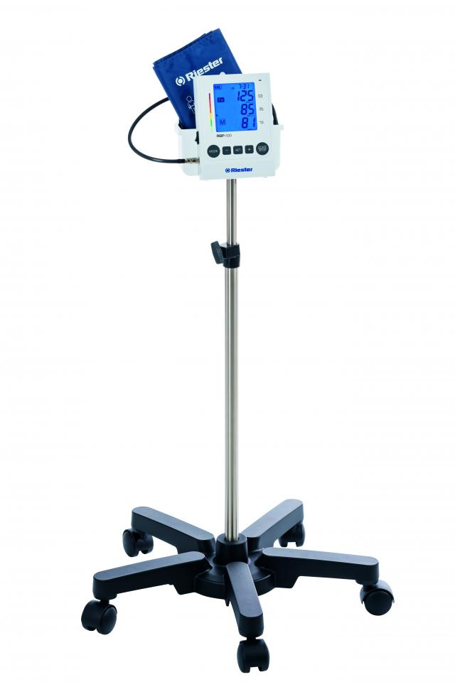
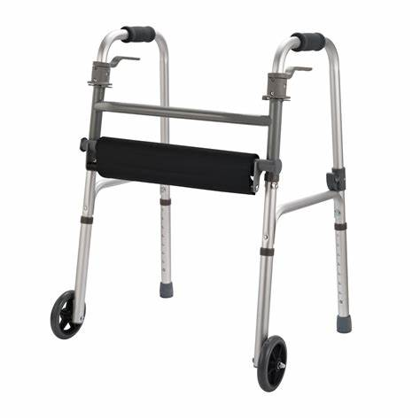
The CLEEN study
CLEaning and Enhanced disiNfection
October results Ward A
70% of shared medical equipment was cleaned
That’s 10% LESS than last month, so there’s still room for improvement
This month we are focusing on cleaning
Infusion pump
Rollator frame
Blood pressure monitor
Resuscitation trolley
COWs
Congratulations to Andy & Napa for the highest % of clean equipment!
For more information, visit cleenstudy.com
Or email Kate at kate.browne@avondale.edu.au

Slide 4
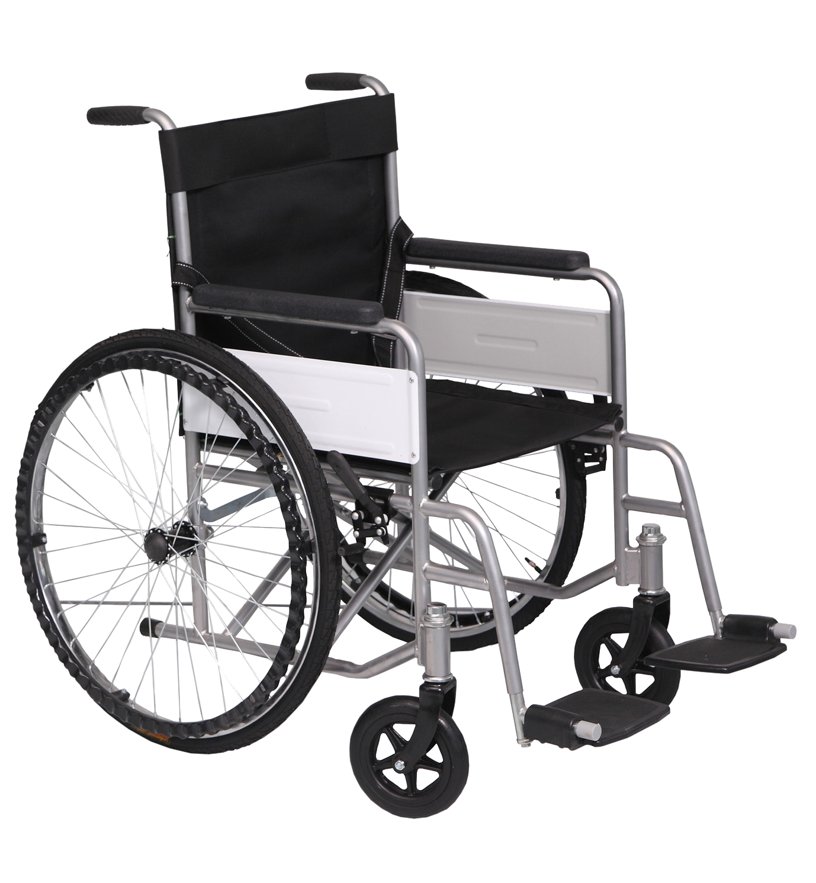
j6
The CLEEN study
CLEaning and Enhanced disiNfection
October results Ward A
75% of shared medical equipment was cleaned
We are aiming for 100% of equipment cleaned, to help protect our patients from infections
This month we are focusing on cleaning
Blood testing kit
Rollator frame
Blood pressure monitor
Medication trolley
Wheelchair
Congratulations to X & and B for the highest % of clean equipment!
For more information, visit XXX
Or email XXX

